Slide 1



Be Safe,
Informed &
Equipped
on Campus

Slide 2
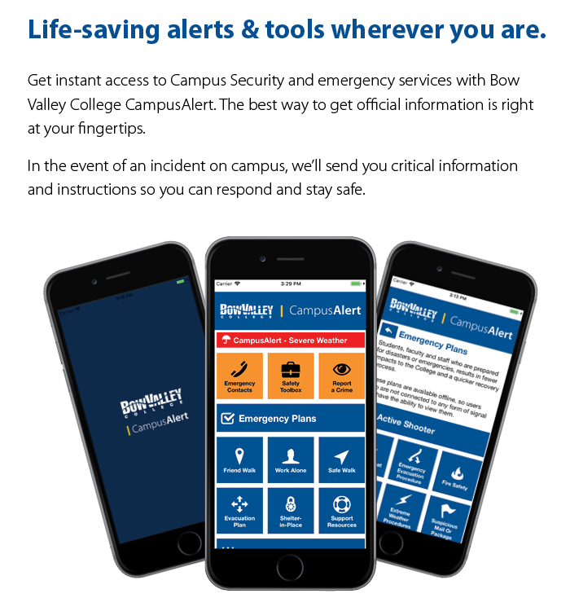
Life-saving alerts & tools
wherever you are.
Free, Easy
Get instant access to Campus Security and emergency services with Bow Valley College CampusAlert. The best way to get official information is right at your fingertips.
In the event of an incident on campus, we’ll send you critical information and instructions so you can respond and stay safe.
Free download for Smartphone devices
Only 18.9 Mb
Won’t drain battery
Privacy protected
All Campus Locations
0

Slide 3
What is an Emergency?
Fire (Real/Drill)
Severe Weather
Hostile Person
Bomb Threat
Chemical Leak
Building Problem
Suspicious Package
Medical Emergency
Evacuation
Power Failure

Slide 4
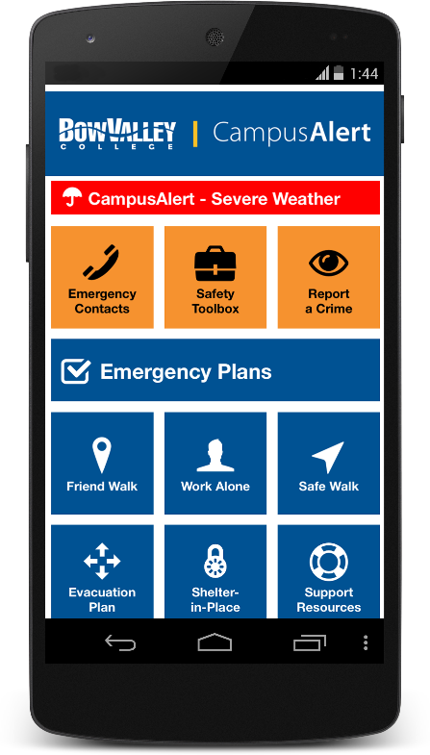
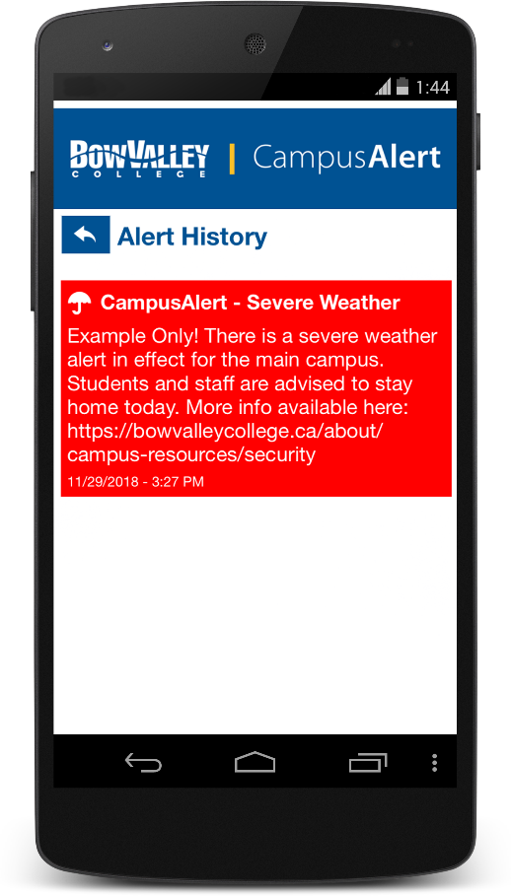
Emergency Messages
Red Alert
Emergency
Alerts
Direct from
College
Important Details
What to Do
Where to Go

Slide 5

Contacts, Safety Tools, Reporting
Orange
Features
Emergency Contacts
Safety
Toolbox
Share Location
I’m OK!
Google Maps
Flashlight
Health & Safety
Building Issues
Share the App
Call Campus
Security
Call 911
Call Security
Police General
Report a Crime
Call Security
Police General
Call 911

Slide 6
Plans, Walking, Working Alone
Blue
Features
Emergency
Plans
Friend
Walk
Active Shooter
Bomb Threat
Evacuation
Fire Safety
Medical Emergency
Extreme Weather
Suspicious
Package
Power Failure
Pick a friend to track your walk
Work/Study
Alone
The app will check in
Press OK
No response —
alerts a friend

Slide 7
Evacuation, Stay in Place, Support
Blue
Features
Safe Walk
Evacuation
Plan
Campus Security will escort you within a
2-block radius
Where to go in the case of an emergency
Support
Services
Shelter in
Place
Learner Success Service
Imagine Health
Counseling
Stay in class
Stay in building

Slide 8

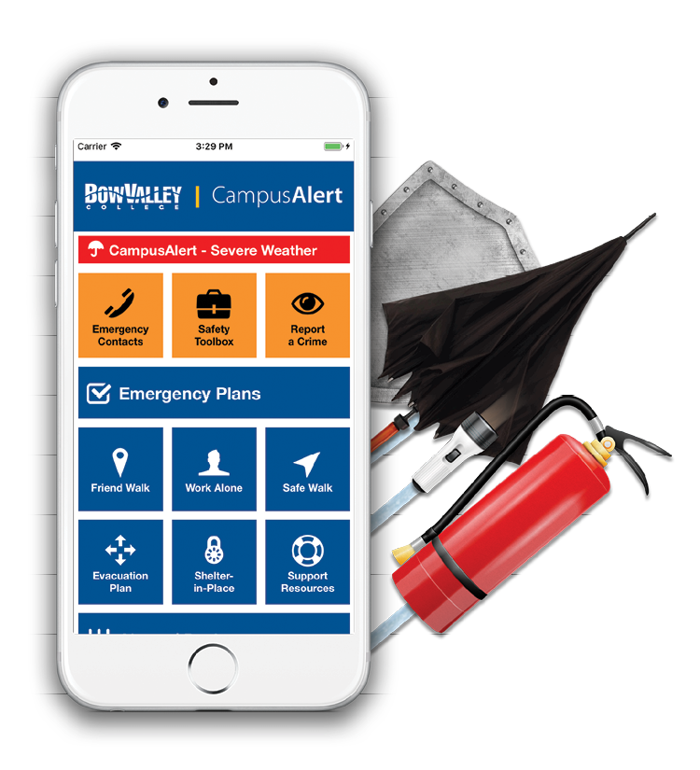


Get your app now!
Download Instructions
Search ‘Bow Valley College CampusAlert’ on the App Store or Google Play.
Download the app to your device and select ‘Allow Notifications.’
Explore the app to find all your tools for staying safe on campus.
If you have issues installing the app, please contact Help Desk at helpdesk@bowvalleycollege.ca or
^{403-410-1611.}

Slide 9

bowvalleycollege.ca/campusalert

